Slide 1

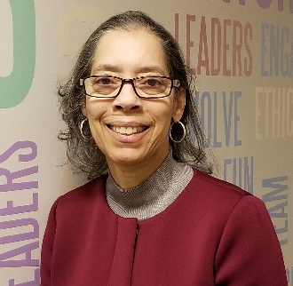

Notes:
Congratulations Class of 2020 on your achievements! As you look forward to your future, the Commonwealth would like you to consider public service as a career.

Slide 2
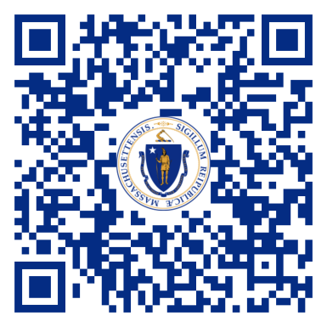
MassCareers
Your Career, the Commonwealth’s Future!
Create a Profile: It’s all about YOU
  Personal Information
  Education
  Employment History
  Licenses and Certifications
  Preferences
    Job Category
    Location
    Agency
Request notification of postings that meet your interest and skill set
Scan the MassCareers
QR Code:
Notes:
We invite you to visit MassCareers and create a profile so you can see the variety of job opportunities that we offer. We are truly committed to making Massachusetts a great place to live, work, start a business and raise a family! Your career is the Commonwealth’s future! Best of luck to you all!

